Slide 1


SANTANDER PRODUCT RECOMMENDATION
TEAM - 5
Team Member
Gaurav Singh
Ajesh DS
Roshan Singh
Abhishek Bollaram
Raghav Agarwal

Slide 2
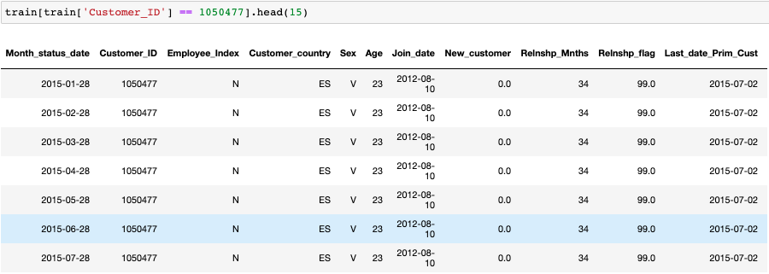
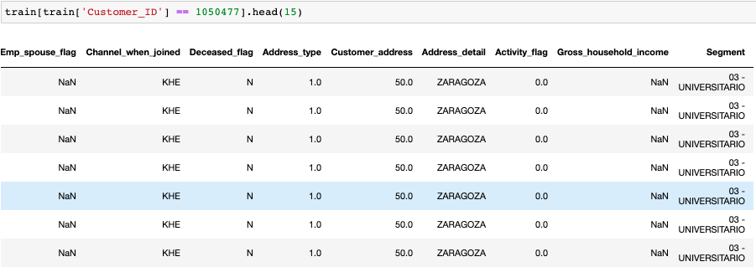
Project Overview
Problem Statement: The goal of this project is to predict what new products the customer will buy in
the next month based on their past behavior and that of similar customers.
Data Size: The size of training data set is about 2.3 GB, which has 13,647,309 observations. The test data set has 929,615 observation.
Input Features: From column 1 to column 24 are the input features, which contain 21 categorical
features and 3 continuous features. The input features contain customers’ demographic and status with the bank information.
Notes:
Picture:
- https://unsplash.com/photos/fkaZiACUb5w

Slide 3
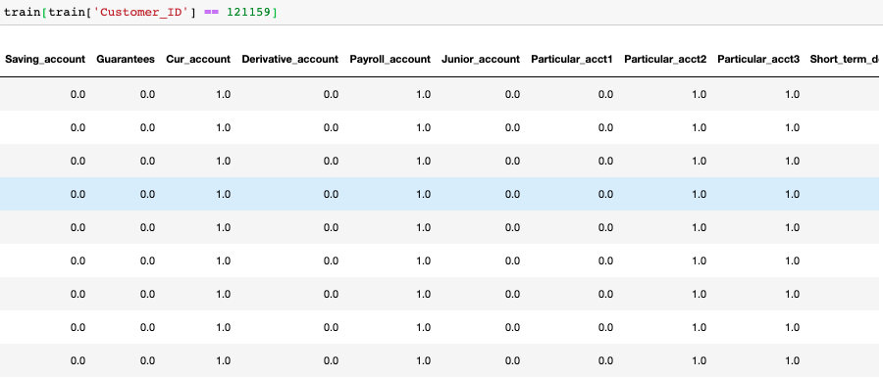
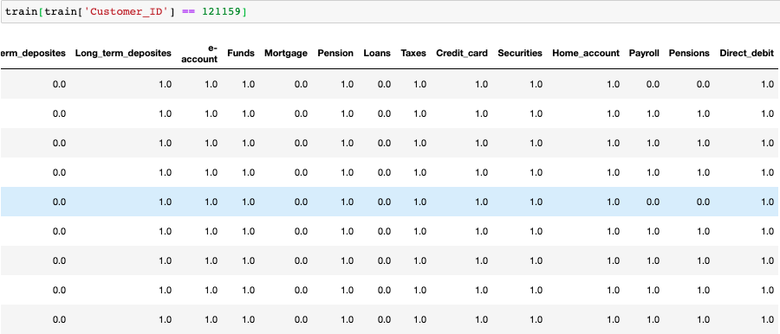
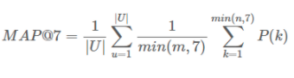
Project Overview
Output Features: From column 25 to column 48 are the output features, which contains the product
purchased information according to each customer from January 2015 to May 2016. Each column stands
for one product, and there are 24 products in total.
Evaluation Metrics: Mean Average Precision @ 7 (MAP@7) where @7 means that we are predicting up to
top 7 financial products that the customer can buy.
Notes:
Picture:
- https://unsplash.com/photos/fkaZiACUb5w

Slide 4
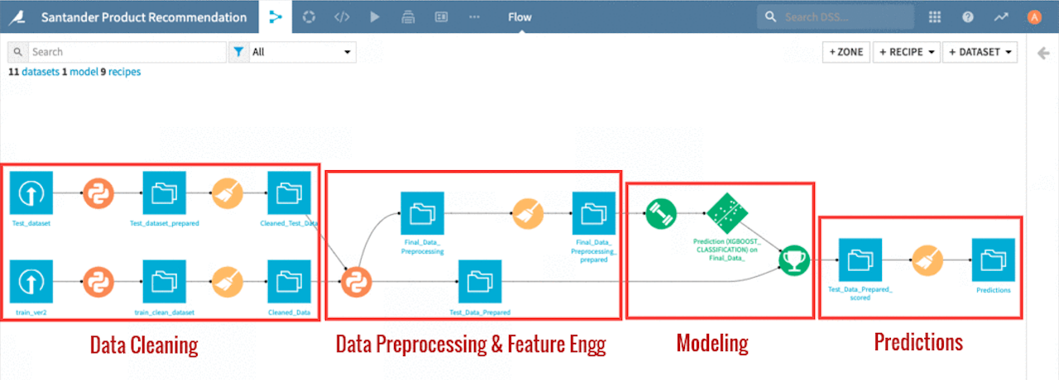
Workflow Diagram
Additionally, our workflow diagram also contain Exploratory Data Analysis (EDA) and User Interface.
Notes:
Picture:
- https://unsplash.com/photos/fkaZiACUb5w

Slide 5
Assumptions
The dataset is representative of the customer base of Santander bank.
The whole project is build on customer dataset given from January 2015 to May 2016.
In product column, zero indicate that customer doesn’t own that product and one indicate that customer
own that product as of that month.
Product recommendation is done through traditional channel when customer visit the bank or through
telephonic conversation.
The product are meant for longer and regular intent of usage apart from some product which have time
constraints like short-term deposit, med-term deposit etc.

Slide 6
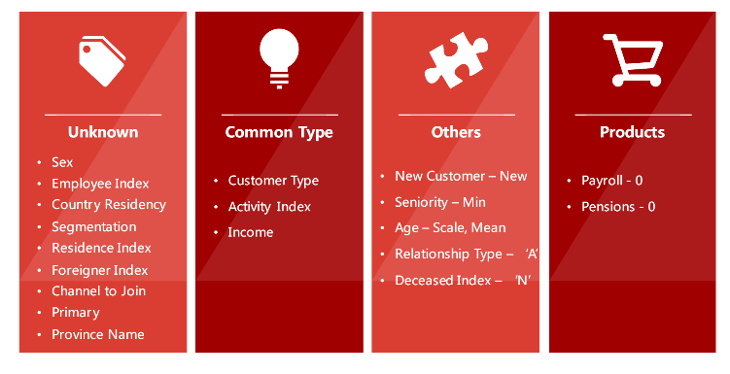
DATA CLEANING
EDA
DATA PREPROCESSING
Feature Engineering
Modeling
Interpretation
Prediction
Divided Imputation broadly into 4 category
Imputation
Dropping Features
Contain missing values:
22 Features
Time Series – Customer
Information
Drop 4 Features:
Having more than 95%
missing values
Repetitive of other features
For the features in the ‘Unknown’ column, the missing values were all labeled as ‘unknown’. The reason is that the features in this column are more
customer’s demographic information. Therefore, in order not to make any assumption, labeling ‘unknown’ was the only way.
For the features in the Common Type column, the median of each features were imputed for the missing values because those were the features that
described the relationship between the bank or continued variable.
The features in the others were imputed by couple different methods. Beside the ‘age’ feature, the missing values of rest of the features were fill in based on treating those observation as new customers. From the EDA, we were discovered that those missing values were the same observations. And within those observations, ‘all the account activities were under 6 months, which were also the bench mark for being a new customers. For the ‘age’ features, the after scaled mean were used for imputation in order to avoid some skewness in the data.
Last but not least, there were two kinds of products having missing values. Due to the evaluation penalized the false negative, we would like to assume that the products haven’t been purchased yet.

Slide 7
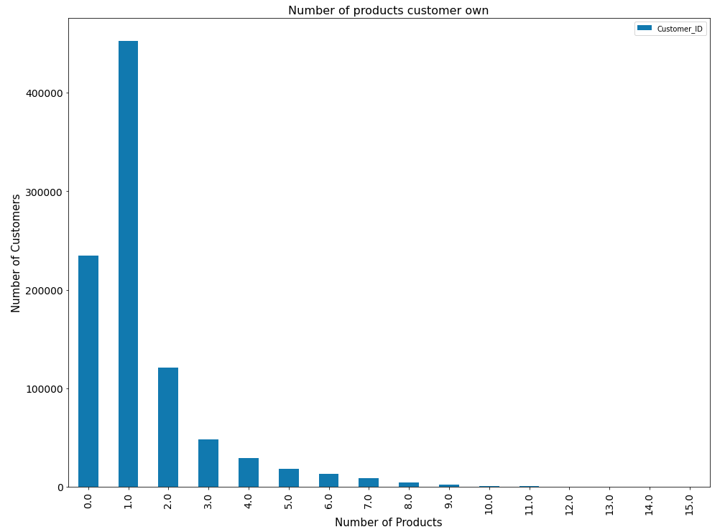
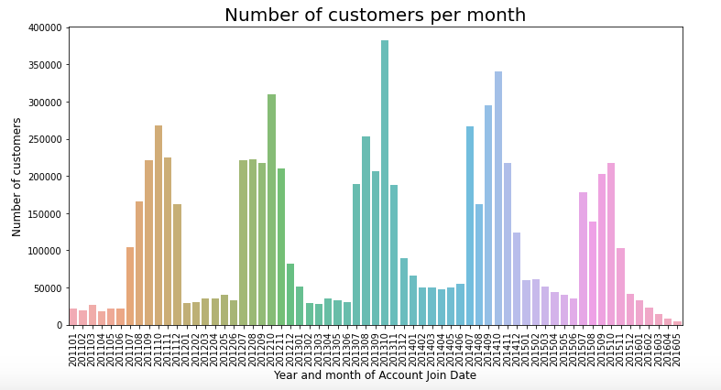
DATA CLEANING
EDA I
DATA PREPROCESSING
Feature Engineering
Modeling
Interpretation
Prediction
Graph showing Seasonality trend and distribution of total number of product owned by customer
OBSERVATION:
Majority of Customer own only one product or not even a single product.
Every year, first 6 months the customers are pretty much the same and there is increase in number of customers from July till
October and then again the number of customers joining go down sharply and settles from January to June.

Slide 8
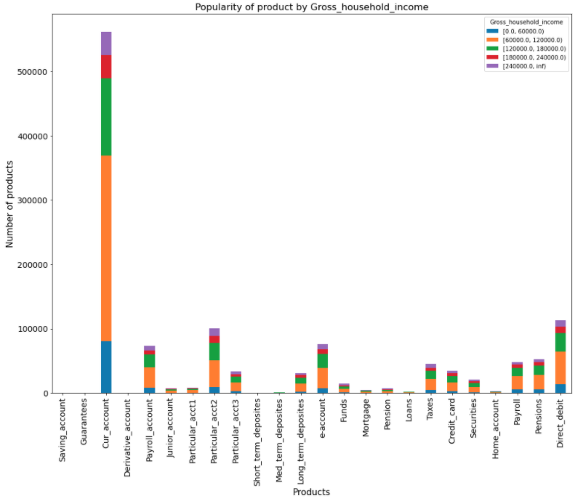
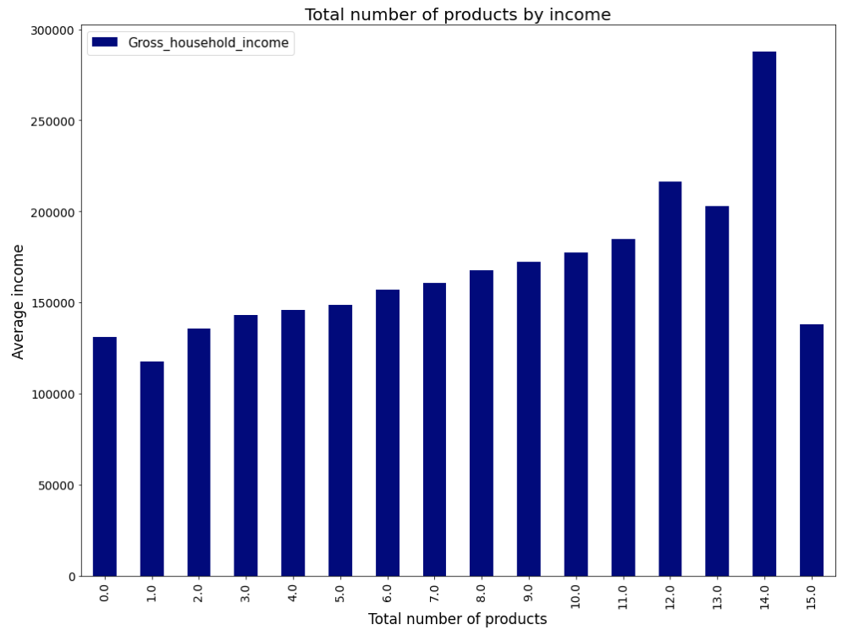
DATA CLEANING
EDA II
DATA PREPROCESSING
Feature Engineering
Modeling
Interpretation
Prediction
Graph showing popularity of products by Gross household Income and distribution of total number of product by Income
OBSERVATION:
Majority of any product holder have income range from 60K - 120K.
Customer having more income buy more products. Average Income above 250K holds 14 number of products.

Slide 9
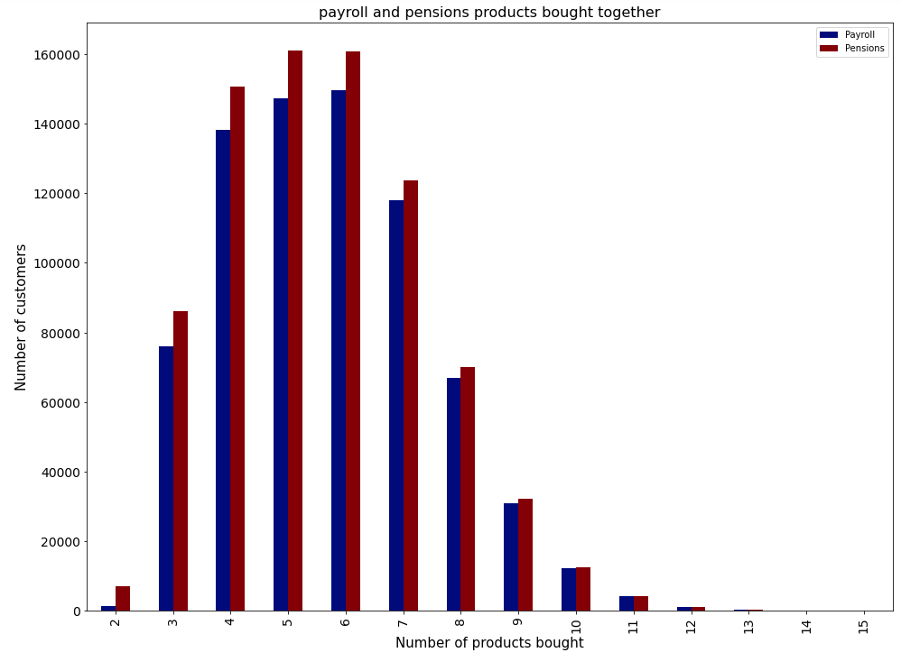
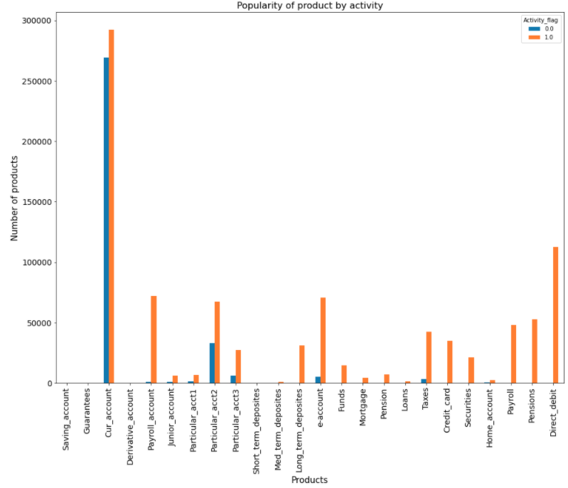
DATA CLEANING
EDA III
DATA PREPROCESSING
Feature Engineering
Modeling
Interpretation
Prediction
Graph showing distribution of Payroll and Pension product and popularity of products by Activity
OBSERVATION:
Customers who are buying Pension product are also buying Payroll product.
Majorly product are owned by Active customers. The products such as Direct Debit, Pensions, Payroll, Securities, Taxes, Pension, Mortgage, Funds,
E-Account, Long_Term_Deposities, Med_Term_Deposities and Payroll_Account are fully owned by Active Customer.

Slide 10
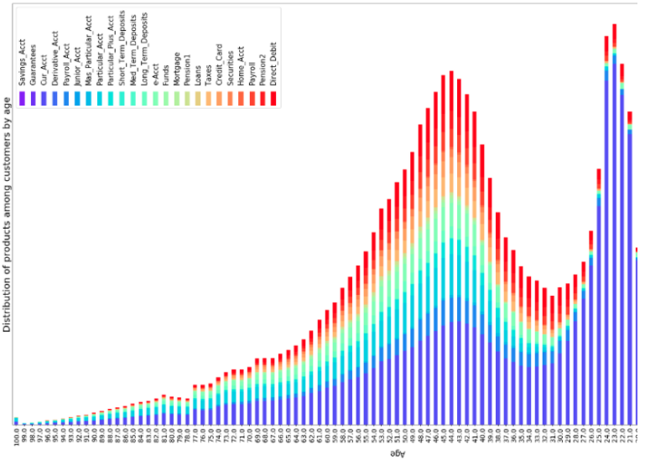
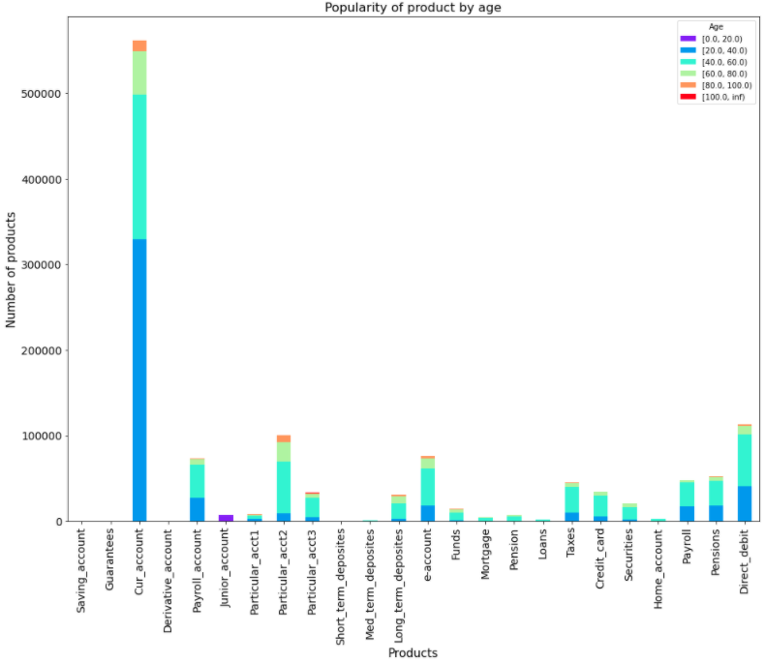
DATA CLEANING
EDA IV
DATA PREPROCESSING
Feature Engineering
Modeling
Interpretation
Prediction
Graph showing popularity of products by Age and distribution of products among customer by Age
OBSERVATION:
The junior Account is hold by only age group from 0-20 years old.
Customer’s aged between 20 to 60, whom we had bucketed into 2 sets aged 20 to 30 and 40 to 60, seemed to show clear preferences towards different choice of products.

Slide 11
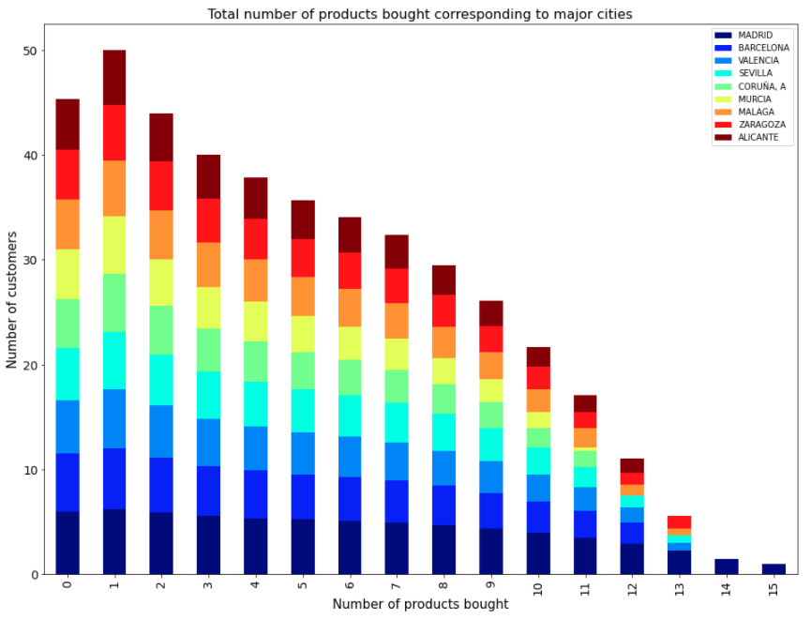
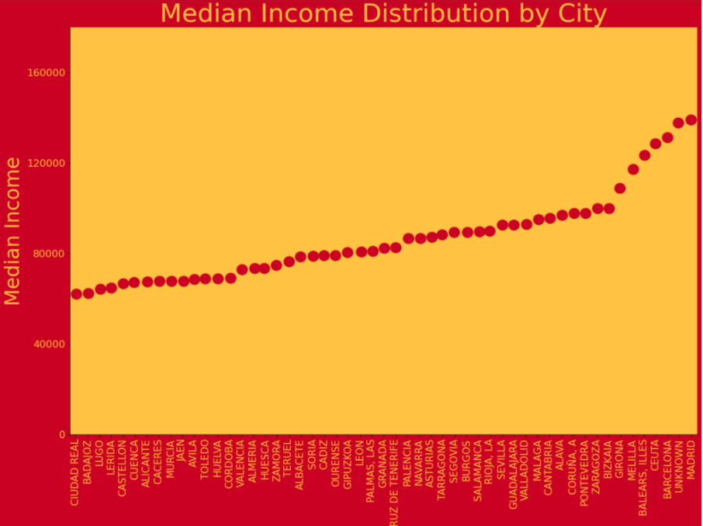
DATA CLEANING
EDA V
DATA PREPROCESSING
Feature Engineering
Modeling
Interpretation
Prediction
Graph showing distribution of total number of product purchased based on cities and median income distribution by cities.
OBSERVATION:
Median income of customers who belong to MADRID, BARCELONA and CEUTA are higher than other customers.
Customer from MADRID, BARCELONA and VALENCIA buys more product than other customers.

Slide 12
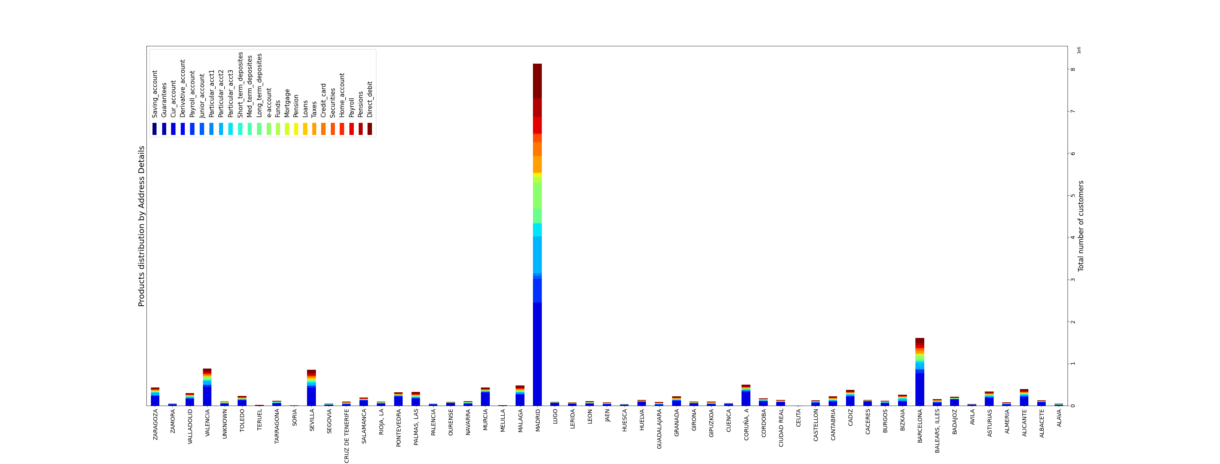
DATA CLEANING
EDA VI
DATA PREPROCESSING
Feature Engineering
Modeling
Interpretation
Prediction
Graph showing distribution of products by Address Details
OBSERVATION:
Majorly customer from MADRID buy more products and then customer from Barcelona and Valencia.

Slide 13
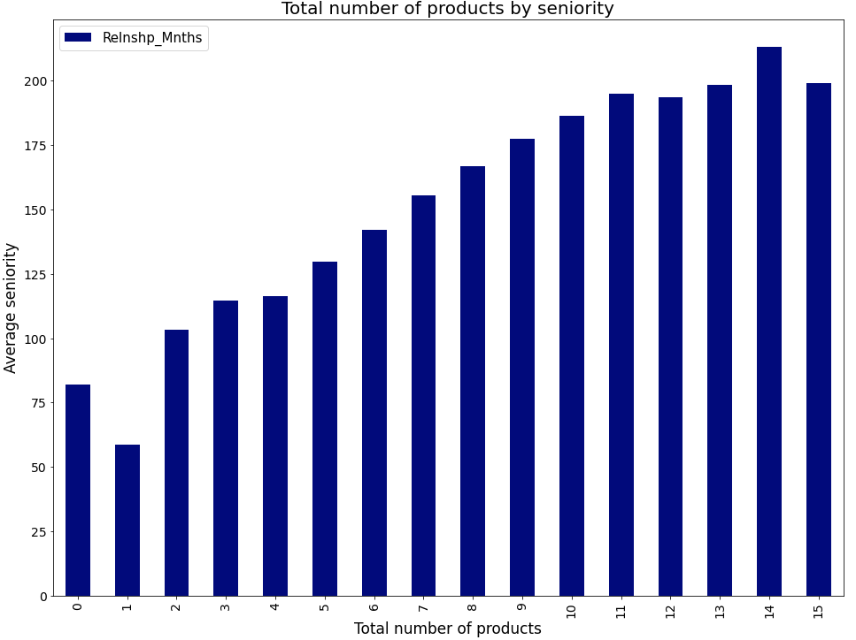
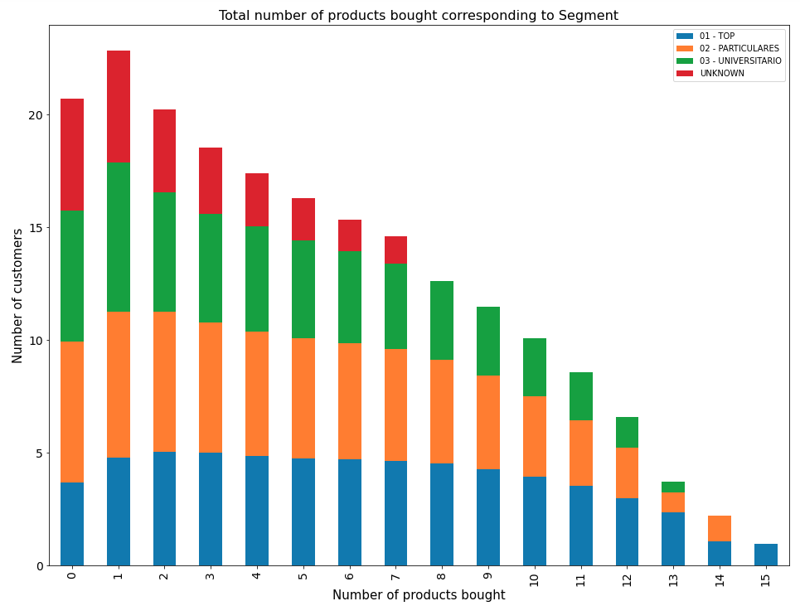
DATA CLEANING
EDA VII
DATA PREPROCESSING
Feature Engineering
Modeling
Interpretation
Prediction
Graph showing distribution of total number of product bought by seniority and segment
OBSERVATION:
Customer with more seniority tends to buy more products.
VIP and Individual Customer segment tend to buy more number of products than other customer segment

Slide 14
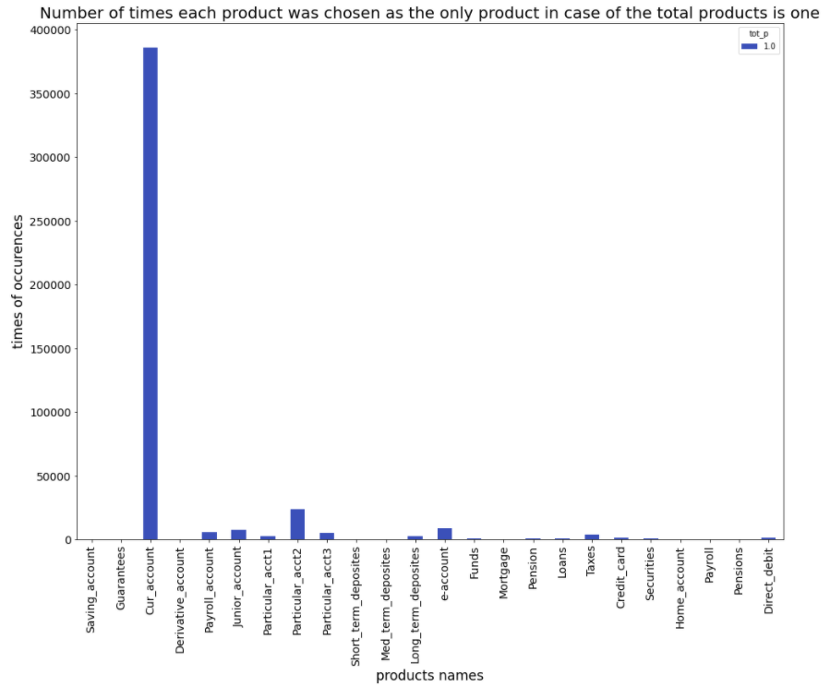
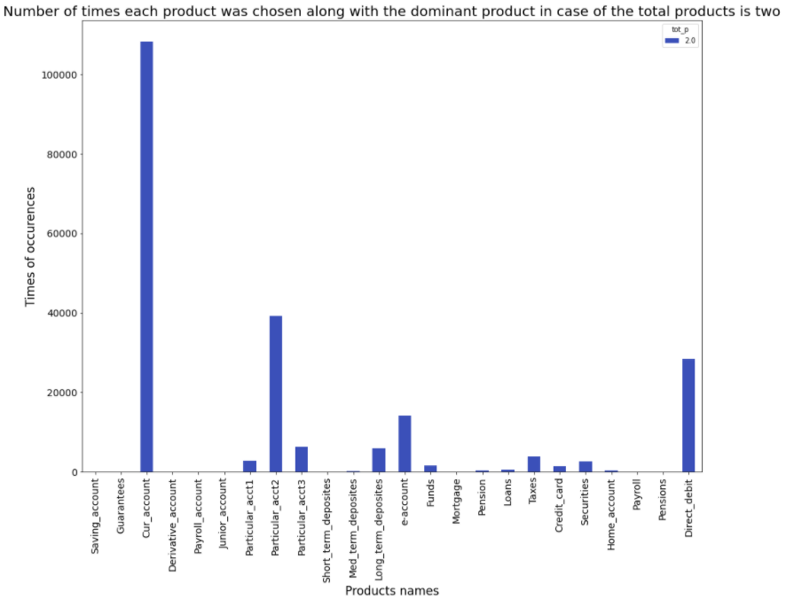
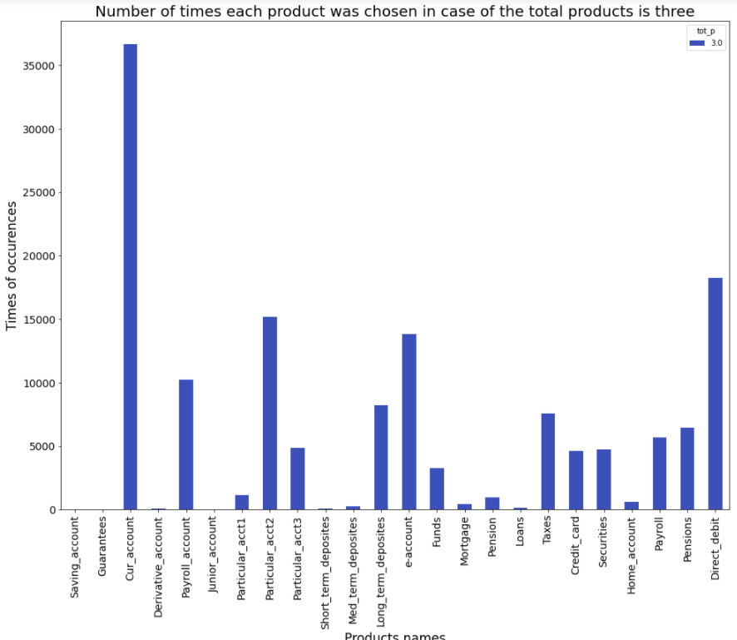
DATA CLEANING
EDA VIII
DATA PREPROCESSING
Feature Engineering
Modeling
Interpretation
Prediction
Graph showing popularity of products based on total of products owned by customer
OBSERVATION:
Among those customers that own only one product, majority of them own Current Account.
Among those customers that own Current Account + one more product, Particular Account_2 is the next best choice for customer, followed by Direct Debit.
Among those customers that own Current Account + two more product, Direct Debit is the other best choice, followed by E-Account, Payroll
Account and Long Term Deposit Account.
Therefore, the top 5 financial products with the most frequent new purchases are Current accounts, Particular Account, Direct Debit ,
E-Account, and Payroll Account.

Slide 15
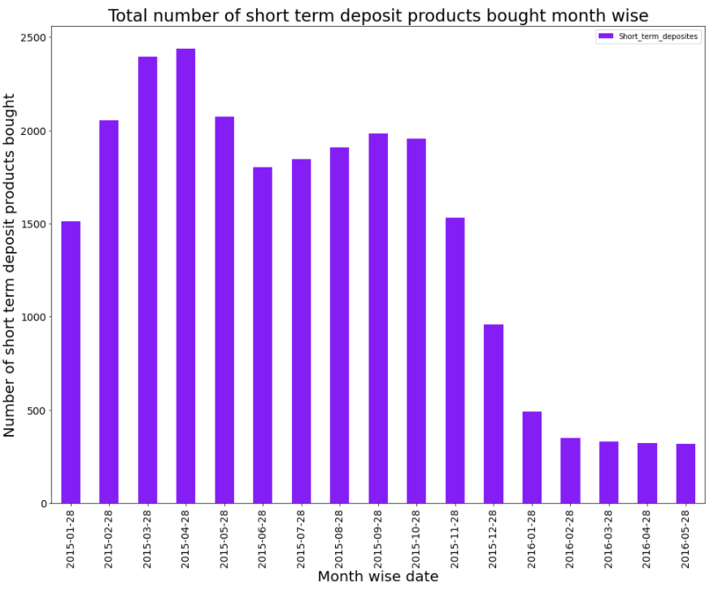
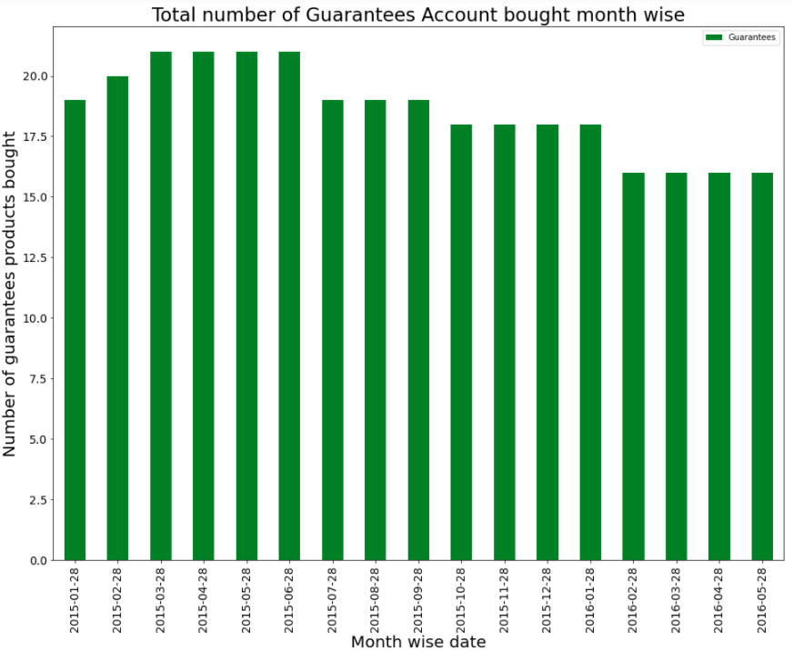
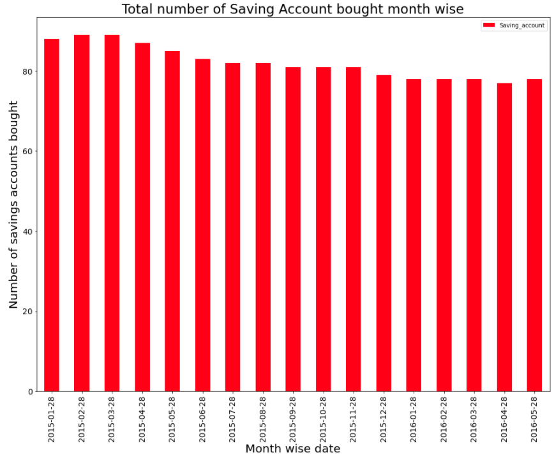
DATA CLEANING
EDA IX
DATA PREPROCESSING
Feature Engineering
Modeling
Interpretation
Prediction
Graph showing distribution of different products bought month wise
OBSERVATION:
Suddenly after November 2015 there is sharp decline in number of customer buying Short Term Deposit.
There is a decline in the number of customer buying Guarantee and Saving account. Also, Very less number of customer buy
Guarantee and Saving account.

Slide 16
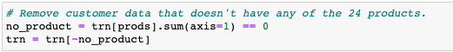
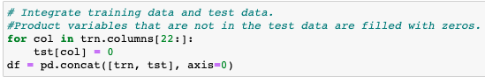
DATA CLEANING
EDA
DATA PREPROCESSING
Feature Engineering
Modeling
Interpretation
Prediction
Data Preprocessing
STEP 1.
STEP 2.
STEP 3.
EXPLANATION:
A zero in product column indicated that the customer did not own that product and one indicated that the customer owned that
product as of that month. So, in STEP 1 we are identifying the customers who bought the products during these 17 months. This
will be the people whom we will be interested in because there is no point in training our model with customers who did not buy
anything.
In STEP 2, we Integrated training data and test data. Training data and test data can be easily distinguished by a date variable
(fecha_dato). The same 24 customer variables are shared, and 22 product variables that are not in the test data are filled with
zeros.
In STEP 3, we have dropped two product i.e., Saving and Guarantee account as they are rarely purchased by customer.

Slide 17
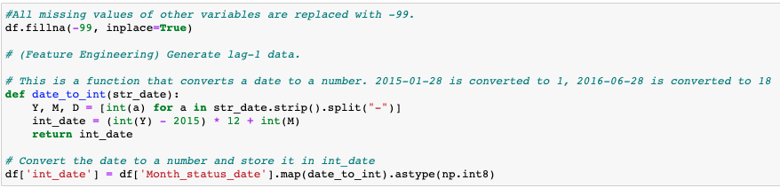
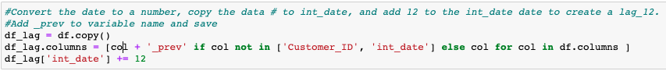
DATA CLEANING
EDA
DATA PREPROCESSING
Feature Engineering
Modeling
Interpretation
Prediction
Feature Engineering
STEP 1.
STEP 2.
EXPLANATION:
In STEP 1, we have converts a date to a number i.e., 2015-01-28 is converted to 1 and 2016-06-28 is converted to 18. We did
this in order to create a lag so that we can compare the current month product purchase behavior of any customer with his/her
previous purchasing behavior in order to train our model.
In STEP 2, we are combining the same month’s customer information from last year as input features, meaning now 46 input
features in total will be used to train the data of June, 2015 train set in order to give the recommendation for June, 2016.

Slide 18
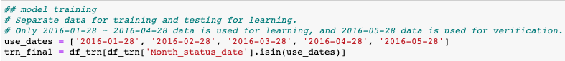
DATA CLEANING
EDA
DATA PREPROCESSING
Feature Engineering
Modeling I
Interpretation
Prediction
Splitting the data
STEP 1.
STEP 2.
EXPLANATION:
A total of 1 year and 6 months worth of data (2015-01-28 ~ 2016-05-28) is provided as training data, and the test data to be predicted is future data (2016-06-28). So, we separate the testing data with the help of Month_status_date for which we have to predict the recommended product for the customer.
In this case, it is common to separate the latest data (2016-05-28) into verification data and use the remaining data as training data even in the internal cross-validation process. In the baseline model, in order to simplify the model, data for a total of 4 months from 2016-01-28 to 2016-04-28 is used as training data, and 2016-05-28 data is used as verification data.

Slide 19
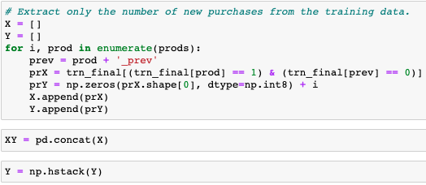
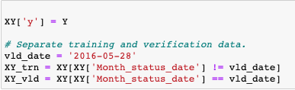
DATA CLEANING
EDA
DATA PREPROCESSING
Feature Engineering
Modeling II
Interpretation
Prediction
Splitting the data
EXPLANATION:
Now as we are interested only in those customer who purchased the new product, so we put the condition where in current month the customer has purchased a product but not in the same month of last year.
Data for a total of 4 months from 2016-01-28 to 2016-04-28 is used as training data, and 2016-05-28 data is used as verification data.
Here the ‘y’ variable on which we are predicting are output is the indexes of the product. Suppose if the customer has bought Current Account and
Direct Debit, then the corresponding index of that will be stored in ‘y’ variable for that customer on that month he purchased the product.

Slide 20
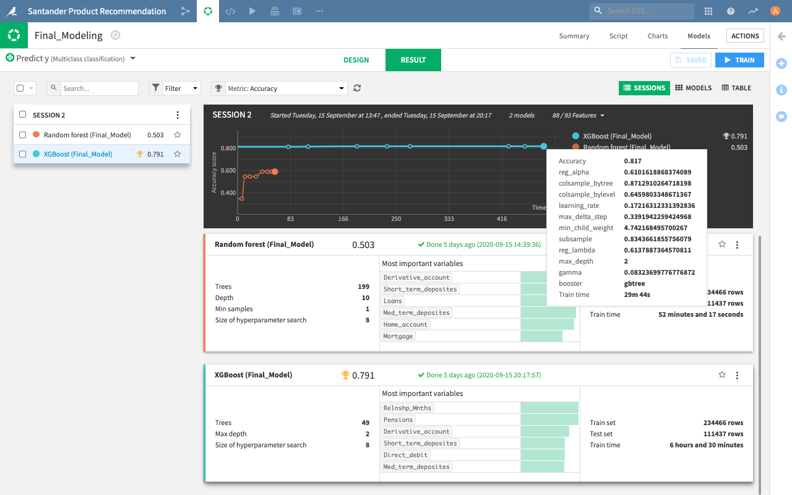
DATA CLEANING
EDA
DATA PREPROCESSING
Feature Engineering
Modeling III
Interpretation
Prediction
Model Selection
EXPLANATION:
In order to find the month which gives the best prediction, three
directions of month selection are
performed by combining the
previous month’s product
information as input features
which are: using the previous
month to predict the current
month, using the month from last
year to predict the same month
of current year, using one month
to predict the situation of three
months later. After that the
logloss from the various runs
are taken out and it is found that
the best way in this dataset to
recommend new products is
based on the same month from
the previous year. Since then,
the data of June, 2015 is used
as the train set to give the
recommendation for June, 2016

Slide 21
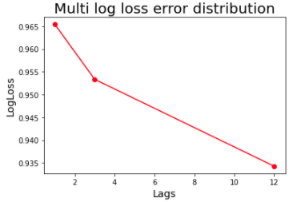
DATA CLEANING
EDA
DATA PREPROCESSING
Feature Engineering
Modeling IV
Interpretation
Prediction
Model Selection
EXPLANATION:
After finalizing that we will use lag 12 for training our model, we have selected Xgboost and Random forest to compare which will give best accuracy and we found that Xgboost is giving the accuracy of approx. 82% while Random forest is giving the accuracy of 61%.

Slide 22
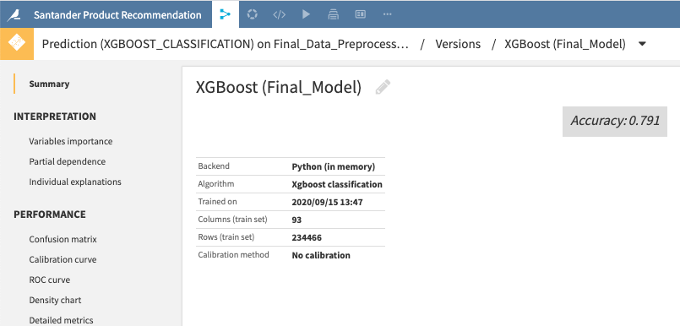
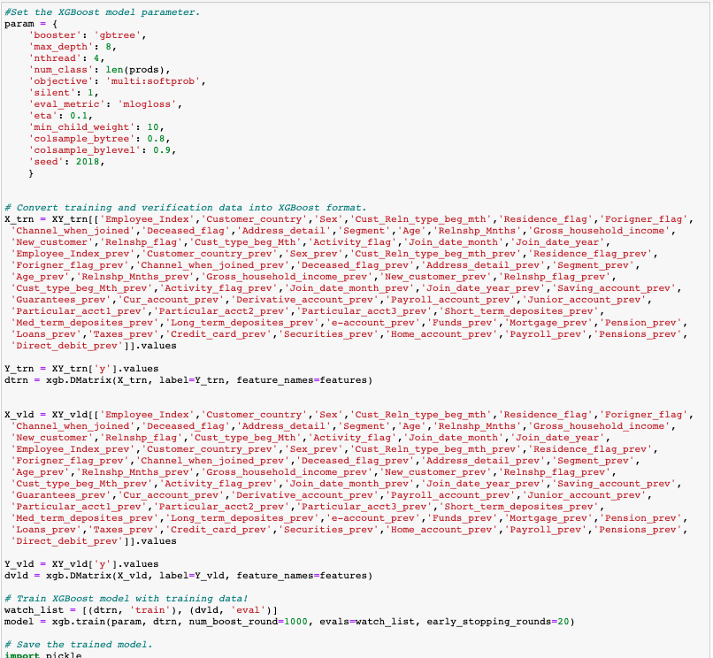
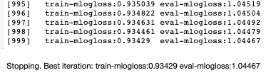
DATA CLEANING
EDA
DATA PREPROCESSING
Feature Engineering
Modeling V
Interpretation
Prediction
Modeling on Xgboost
EXPLANATION:
After training the model on Dataiku tool for a range of Hyper parameter, we got the optimal parameter on which we separately trained the model on
juypter notebook to check the accuracy of our model.

Slide 23
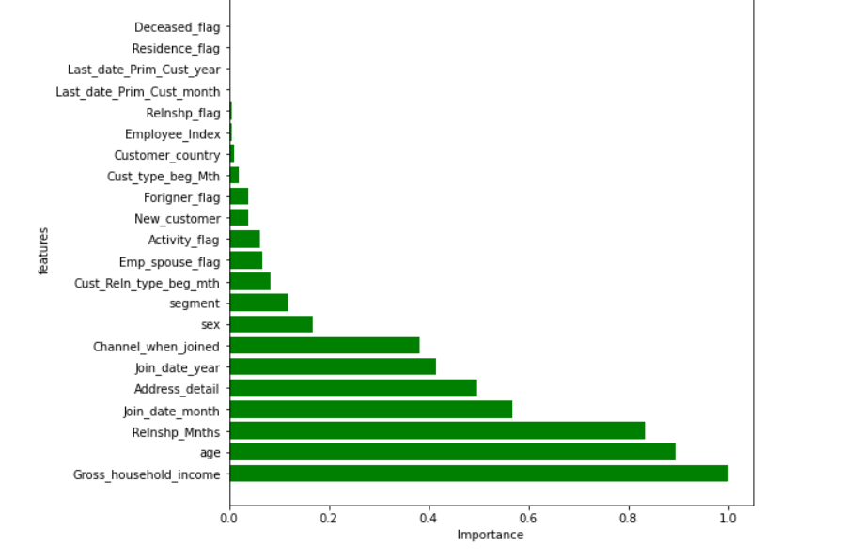
DATA CLEANING
EDA
DATA PREPROCESSING
Feature Engineering
Modeling
Interpretation
Prediction
Feature Importance Chart
EXPLANATION:
This graph represents the importance of each attribute scaled between 1 and 0. This is a useful inference drawn from the
training dataset as it represents all the important characteristics describing future predictions. The top five most important
features that affect the recommendation of product are: Gross household Income, Age, Relationship Month with the bank,
Customer Seniority, Joining Month and Customer City.

Slide 24
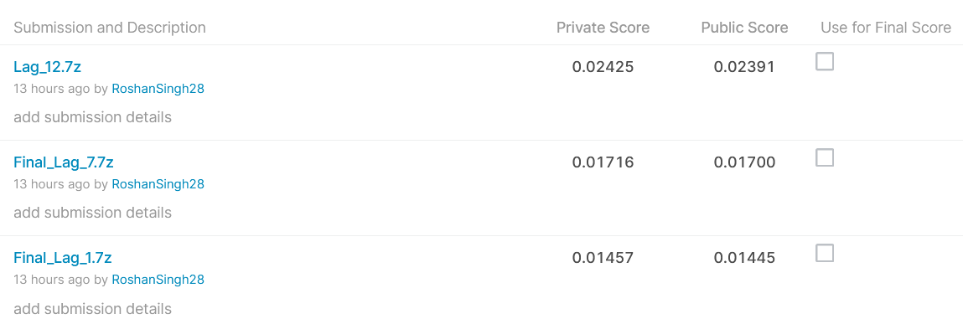
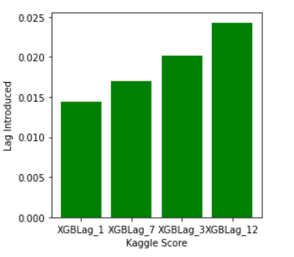
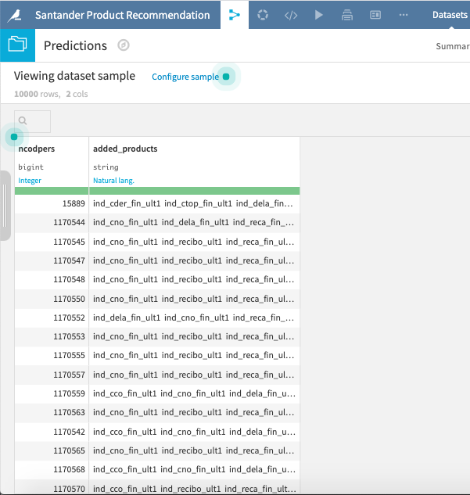
DATA CLEANING
EDA
DATA PREPROCESSING
Feature Engineering
Modeling
Interpretation
Prediction I
MAP@7 Score for Different lag
Top 7 recommended product for different customers
EXPLANATION:
After training our model on different lag variable, we can see that we observe best results for 12 months i.e. a year. Hence we can see that the customer buying
behaviour is largely dependent on seasonality of the products. As depicted in the
data visualisation customers tend to buy more products with respect to seasons
and festivals. It is analogous to months of (Oct-Nov) in Indian calendar due to
festive seasons.
We have predicted Top 7 products that are arranged in decreasing order of their
predicted probability.

Slide 25
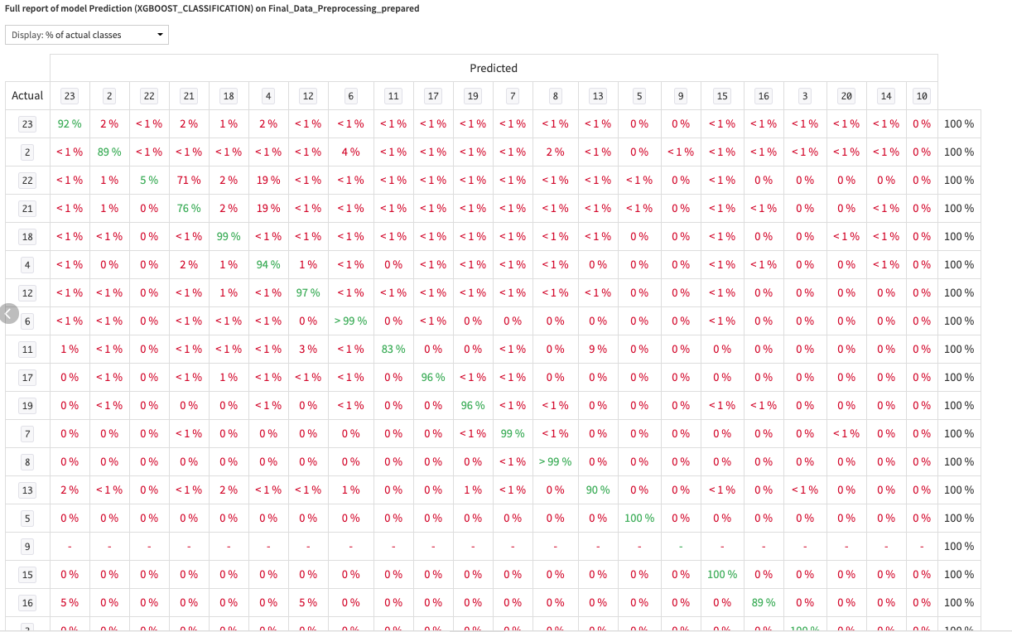
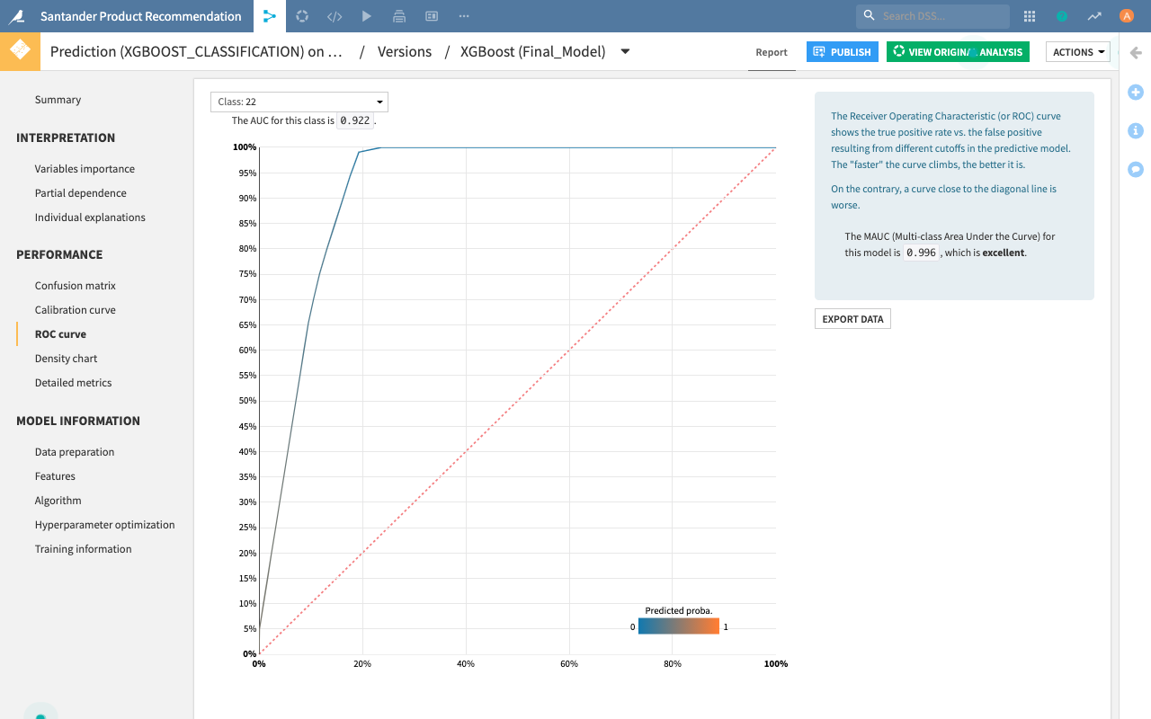
DATA CLEANING
EDA
DATA PREPROCESSING
Feature Engineering
Modeling
Interpretation
Prediction II
Confusion Matrix
ROC Curve
EXPLANATION:
The confusion matrix shows that our model is correctly predicting the majority of the class above 85%.
The ROC Curve for class 23 indicate that we have predicted 92% times correct prediction for Direct Debit product and
similarly for other product we have predicted the correct prediction by at least 85%.

Slide 26


Expected Business Benefit
Increase in sales of product through personalized advertisement
Reduce the costs through targeted marketing
Easy measurement of employee’s performance
Insights on product performance

Slide 27
Project Timeline and Author Contribution

Slide 28

THANK YOU

Slide 29
Q & A

